Slide 1
C H A P T E R
4
PROJECT MANAGEMENT
Notes:
Chapter 2 Information System Building Blocks
Page 2-<number>
This repository of slides is intended to support the named chapter. The slide repository should be used as follows:
Copy the file to a unique name for your course and unit.
Edit the file by deleting those slides you don’t want to cover, editing other slides as appropriate to your course, and adding slides as desired.
Print the slides to produce transparency masters or print directly to film or present the slides using a computer image projector.
Each slide includes instructor notes. To view those notes in PowerPoint, click left on the View Menu; then click left on Notes View sub-menu. You may need to scroll down to see the instructor notes.
The instructor notes are also available in hard copy as the Instructor Guide to Accompany Systems Analysis and Design Methods, 5/ed. Contact your Irwin/McGraw-Hill sales representative if you need a hard copy.

Slide 2
Proyek dan Manajemen Proyek
Proyek adalah urutan (sementara) aktifitas-aktifitas unik, kompleks, dan terkoneksi yang memiliki satu tujuan atau sasaran dan harus dilengkapi dengan waktu yang spesifik,sesuai dengan anggaran dan sesuai dengan spesifikasi.
Manajemen Proyek adalah proses melingkupi, merencanakan, menyediakan staf, mengorganisasi, mengarahkan dan mengontrol pengembangan sebuah sistem yang dapat diterima dengan biaya minimal dan dalam jangka waktu tertentu.
Notes:
Chapter 2 Information System Building Blocks
Page 2-<number>
Teaching Tips
Key point to emphasize is that every IT project is unique, a factor that has made project management extremely challenging across the industry. Organizations today are placing considerably more importance on project management skills because of the impact information technology has on the business. Because of the tremendous amount of monies spent on reengineering systems because of Y2K or ERP, organizations can’t afford the project failures which were very much commonplace in the past.
Project management is a cross life cycle activity.
It can be useful to characterize process management as providing the “templates” (much as a word processor) for project management. But just as word processing templates must be managed and improved from time to time, so must process templates be improved and managed.
.

Slide 3
Manajemen Proyek versus Manajemen Proses
Manajemen Proyek adalah proses melingkupi, merencanakan, menyediakan staf, mengorganisasi, mengarahkan dan mengontrol pengembangan sebuah sistem yang dapat diterima dengan biaya minimal dan dalam jangka waktu tertentu.
Manajemen Proses adalah aktifitas mendokumentasi,mengelola dan secara terus menerus memperbaiki proses pengembangan sistem.
Notes:
Chapter 2 Information System Building Blocks
Page 2-<number>
Teaching Notes
Most organizations pursuing the CMM are targeting Level 3, that is, consistently using a standardized process or methodology to develop all systems. CMM Level 2 deals with project management. CMM Level 3 deals with what has come to be known as process management.

Slide 4
Project dianggap sukses jika :
  Sistem yang dihasilkan diterima oleh pelanggan.
  Sistem Informasi yang dihasilkan tepat waktu
  Sistem Informasi yang dihasilkan sesuai dengan anggaran
  Proses pengembangan sistem memiliki impak minimal pada operasi-operasi bisnis yang berkesinambungan
Notes:
Chapter 2 Information System Building Blocks
Page 2-<number>
Teaching Tips
Emphasize that these measurements are from the perspective of the project manager.
Failures and limited successes far outnumber successful information systems. Some studies show that 60-75% of all IT projects can be considered failures.

Slide 5
Penyebab Kegagalan suatu Proyek
Kegagalan untuk membentuk komitmen manajemen atas pada proyek.
Kurangnya komitmen organisasi pada metodologi pengembangan sistem
Mengambil jalan pintas tanpa melalui metodologi penelitian
Manajemen ekspektasi yang buruk
Komitmen dini dalam menetapkan anggaran dan jadual
Teknik estimasi yang kurang baik
Terlalu optimis
The mythical man-month (Brooks, 1975)
Kurangnya ketrampilan manajemen
Kegagalan beradaptasi dengan perubahan bisnis
Sumber daya yang tidak mencukupi
Kegagalan dalam mengelola perencanaan
Notes:
Chapter 2 Information System Building Blocks
Page 2-<number>
Teaching Notes
The major cause of project failure—most project managers were not educated or trained to be project managers! Just as good programmers don't always go on to become good systems analysts, good systems analysts don't automatically perform well as project managers. To be a good project manager, you should be educated and skilled in the “art of project management.”

Slide 6
Kompetensi-kompetensi Manajer Proyek
Kesadaran berbisnis
Orientasi rekan bisnis
Komitmen pada kualitas
Inisiatif
Pengumpulan informasi
Pemikiran analisis
Pemikiran Konseptual
Kesadaran antarpersonal
Kesadaran organisasi
Antisipasi impak
Banyak menggunakan pengaruh
Memotivasi orang lain
Ketrampilan komunikasi
Mengembangan orang lain
Memonitor dan Mengontrol
Kepercayaan diri
Manajeman stres
Kepedulian pada kredibilitas
Fleksibilitas
(Adapted from Wysocki, Beck, and Crane, Effective Project Management: How to Plan, Manage, and Deliver Projects on Time and within Budget.)
Notes:
Chapter 2 Information System Building Blocks
Page 2-<number>
Teaching Notes
There exists a core set of competencies that good project managers possess. Some of these competencies can be taught, both in courses, books, and professional workshops; however, you should immediately recognize that some of these competencies come only with professional experience in the field. First, you usually cannot manage a process you have never used. Second, you cannot manage a project without understanding the business and culture that provides a context for the project.

Slide 7
Fungsi-Fungsi Manajemen Proyek
  Scoping (ruang lingkup)
  Planning (Perencanaan)
  Estimating (Perkiraan)
  Scheduling (Penjadualan)
  Organizing (Pengorganisasian)
  Directing (Pengarahan)
  Controlling (Pengontrolan)
  Closing (Penutupan)
Notes:
Chapter 2 Information System Building Blocks
Page 2-<number>
Teaching Notes
The project management functions were derived from classic management functions.
Project management functions are dependent upon interpersonal communications between the project manager, the team, and other managers.

Slide 8
Peralatan dan Teknik Manajemen Proyek
PERT chart adalah model jaringan grafis yang menggambarkan tugas-tugas proyek dan hubungan antara tugas-tugas tersebut.
Gantt chart adalah bagan batang horizontal sederhana yang menggambarkan tugas-tugas proyek berdasarkan kalender. Tiap batang diberi nama untuk mewakili setiap tugas proyek. Tugas-tugas tersebut didaftar secara vertikal pada kolom kiri. Pusat horizontal adalah garis waktu kalender.
Notes:
Chapter 2 Information System Building Blocks
Page 2-<number>
Teaching Notes
PERT, which stands for Project Evaluation and Review Technique, was developed in the late 1950s to plan and control large weapons development projects for the U.S. Navy.
The Gantt chart, first conceived by Henry L. Gantt in 1917, is the most commonly used project scheduling and progress evaluation tool.
The tools are not mutually exclusive (especially when PERT is based on “activity on the node” conventions). That is why (and how) most project management software tools maintain both views simultaneously.

Slide 9
PERT Chart
Project Initiation
Legend
5-3-2001
N/A
5-3-2001
N/A
Task
Task
Scheduled
Scheduled
intertask
Scheduled
Scheduled
Start
Finish
dependency
Start
Finish
Actual Start
Actual
Actual Start
Actual
Preliminary Investigation
Finish
Finish
5-3-2001
5-12-2001
5-3-2001
5-11-2001
Problem Analysis
Requirements Analysis
Decision Analysis
5-12-2001
6-12-2001
5-28-2001
7-15-2001
6-13-2001
7-30-2001
5-12-2001
6-14-2001
5-30-2001
7-18-2001
6-13-2001
8-3-2001
Design
Construction
7-3-2001
9-25-2001
7-19-2001
11-13-2001
7-5-2001
10-9-2001
7-20-2001
In Progress
Implementation
9-10-2001
12-14-2001
TBD
TBD
Notes:
Chapter 2 Information System Building Blocks
Page 2-<number>
Teaching Tips
PERT was developed to make clear the interdependence between project tasks before those tasks are scheduled. The boxes represent project tasks (we used phases from Chapter 3). (The content of the boxes can be adjusted to show various project attributes such as schedule and actual start and finish times.) The arrows indicate that one task is dependent upon the start or completion of another task.
The “data” recorded in the nodes on a PERT chart vary with project management software tools. Microsoft Project supports different combinations of data in the nodes.
See the comments at the beginning of the IG for an explanation of the “activity on the node: convention.

Slide 10
Gantt Chart
2001
ID
Task Name
May
Jun
Jul
Aug
Sep
Oct
Nov
Dec
1
Preliminary investigation
2
Problem analysis
3
Requirements analysis
4
Decision analysis
5
Design
6
Construction
7
Implementation
Today
Legend
Complete Task
Incomplete Task
Notes:
Chapter 2 Information System Building Blocks
Page 2-<number>
Teaching Tips
Gantt charts offer the advantage of clearly showing overlapping tasks, that is, tasks that can be performed at the same time. The bars can be shaded to clearly indicate percentage completion and project progress. The figure demonstrates which phases are ahead and behind schedule at a glance. The popularity of Gantt charts stems from their simplicity—they are easy to learn, read, prepare, and use.

Slide 11
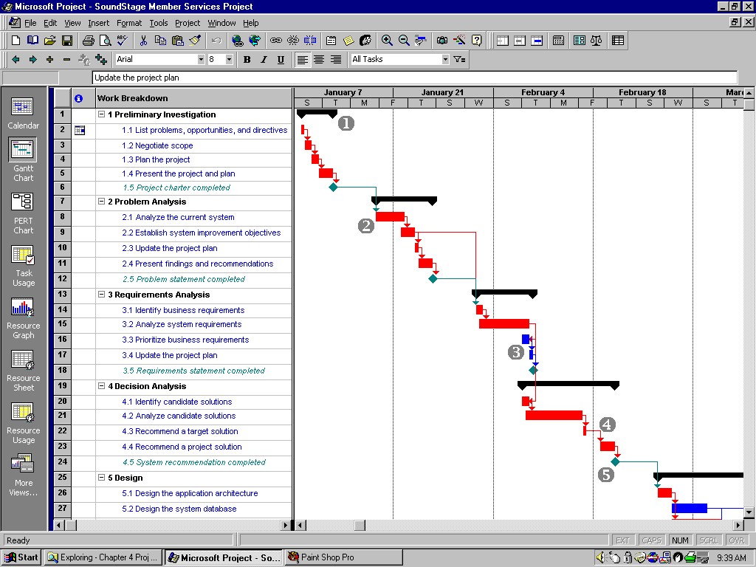
Microsoft Project Gantt Chart
Notes:
Chapter 2 Information System Building Blocks
Page 2-<number>
Teaching Tips
The previous slide’s Gantt chart was built using Microsoft Visio. This one was built with Microsoft Project.
Emphasize that Gantt charts can also show milestones and intertask dependencies.

Slide 12
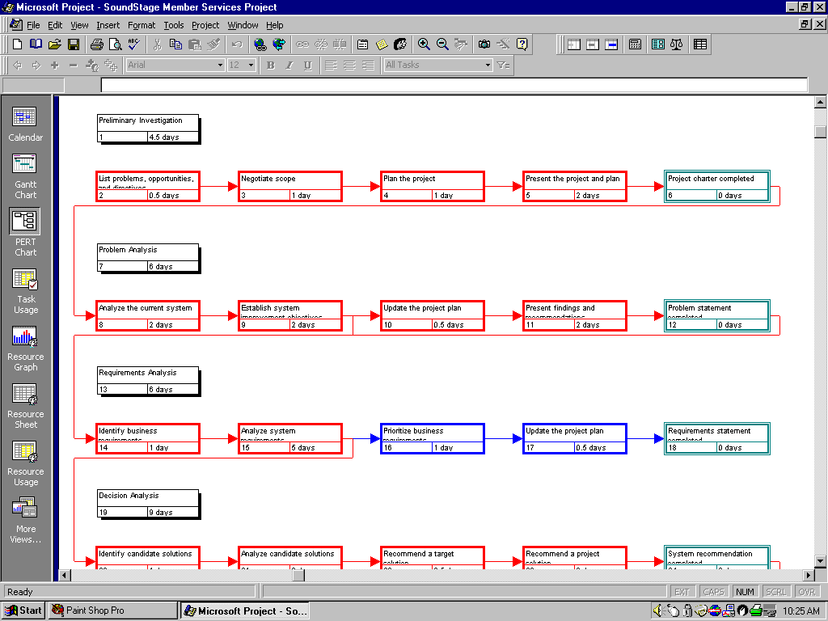
Microsoft Project PERT Chart
Notes:
Chapter 2 Information System Building Blocks
Page 2-<number>
Teaching Tips
Notice that summary tasks do not have dependencies and are represented in black. The authors chose to use red to depict critical tasks (discussed later in the chapter. Milestones are depicted in teal.

Slide 13
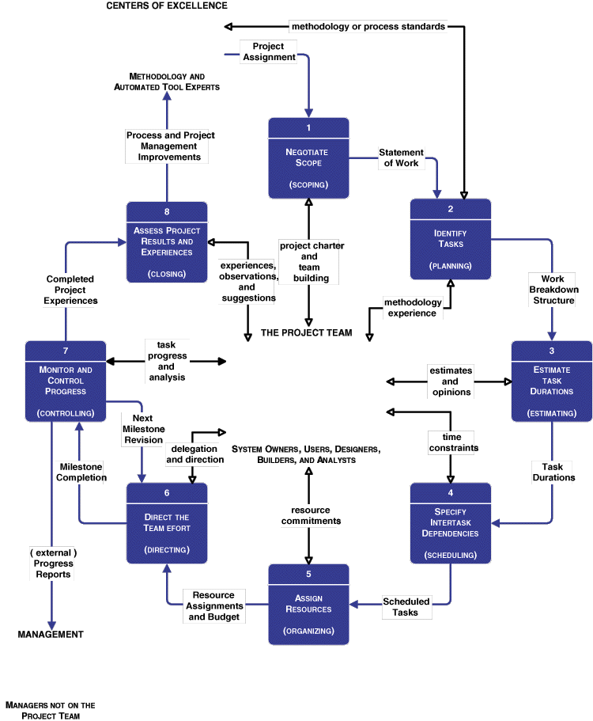



Siklus Hidup Manajemen Proyek
Notes:
Chapter 2 Information System Building Blocks
Page 2-<number>
This slide becomes the organizing model for the rest of the chapter.

Slide 14
Strategi Perencanaan Proyek
Joint project planning (JPP) / Perencanaan Proyek gabungan adalah strategi tempat semua stake holder dalam proyek (para pemilik, pengguna, analisis, desainer dan pengembang sistem) berpartisipasi dalam seminar manajem proyek selama satu sampai tiga hari, dan hasilnya adalah konsesus lingkup, jadual, sumber daya dan anggaran proyek. (Seminar atau pertemuan selanjutnya mungkin diperlukan untuk menyesuaikan dengan lingkup, anggaran dan jadual).
Notes:
Chapter 2 Information System Building Blocks
Page 2-<number>
No additional notes

Slide 15
Aktifitas 1 : Menegosiasikan Lingkup
Scope / lingkup mendefinisikan batas-batas sebuah proyek — Apa saja bagian bisnis yang dipelajari, dianalisa, dirancang, dikonstruksi, diimplementasi, dan yang terakhir diperbaiki?
  Produk
  Kualitas
  Waktu
  Biaya
  Sumber Daya
Statement of work / Pernyataan Kerja yang merupakan deskripsi naratif pekerjaan yang dilakukan sebagai bagian sebuah proyek. Atau dengan kata lain merupakan scope statement (pernyataan lingkup), project definition (definisi proyek), project overview (tinjauan proyek) dan document of understanding (dokumen kesepahaman)
Notes:
Chapter 2 Information System Building Blocks
Page 2-<number>
Teaching Notes
In consulting engagements, the statement of work has become a commonly used contract between the consultant and client. But the approach works equally well for internal system development projects to establish a contract between business management and the project manager and team.

Slide 16
Statement of Work / Pernyataan Kerja
I. Tujuan
II. Latar Belakang
A. Pernyataan masalah, kesempatan atau perintah
B. Sejarah permintaan proyek
C. Tujuan dan sasaran proyek
D. Deskripsi proyek
III. Lingkup
(Perhatikan penggunaan blok-blok pembangun sistem informasi
A. Para stake holder
B. Data
C. Proses - proses
D. Lokasi
IV. Pendekatan Proyek
A. Rute
B. Produk jadi
V. Pendekatan Manajerial
A. Alasan pembentukan tim
B. Manajer dan pengalaman
C. Persyaratan pelatihan
D. Jadual Pertemuan
E. Metode dan frekuensi pelaporan
F. Manajemen Konflik
G. Manajemen lingkup
Notes:
Chapter 2 Information System Building Blocks
Page 2-<number>
No additional notes

Slide 17
Statement of Work / Pernyataan Kerja
VI. Batasan-batasan
A. Tanggal mulai
B. Tanggal berakhir
C. Anggaran
D. Tehnologi
VII. Perkiraan Ballpark
A. jadual
B. Anggaran
VIII. Persyaratan kepuasan
A. Kriteria sukses
B. Asumsi-asumsi
C. Resiko-resiko
IX. Apendiks
Notes:
Chapter 2 Information System Building Blocks
Page 2-<number>
No additional notes

Slide 18
Aktifitas 2: mengidentifikasi Tugas-tugas
Work breakdown structure (WBS) adalah peralatan grafis yang digunakan untuk mengilustrasikan penguraian hirarkis sebuah proyek menjadi fase-fase, aktifitas-aktifitas dan tugas-tugas
Milestones (kejadian penting) adalah suatu kejadian yang menandakan penyelesaian produk jadi sebuah proyek besar.
Biasanya untuk membedakan milistones dari tugas-tugas lain dalam WBS dengan menggunakan format khusus, misalnya italics (huruf miring)
Notes:
Chapter 2 Information System Building Blocks
Page 2-<number>
Teaching Notes
A WBS may or may not specify milestones.
Teaching Tips
Tasks must be broken down to a level at which they are manageable. Some experts suggest that a task must be accomplished within 40 working hours or further subdivided into tasks until they can.

Slide 19
Work Breakdown Structures
0
PROJECT
GOAL
1 Phase 1 of the project …
2 Phase 2 of the project …
2.1 Activity 1 of Phase 2 …
2.2 Activity 2 of Phase 2
2.2.1 Task 1 of Activity 2.2 in Phase 2
2.2.2 Task 2 of Activity 2.2 in Phase 2
2.2.3 Task 3 of Activity 2.2 in Phase 2
2.3 Activity 3 of Phase 2 …
3 Phase 3 of the project …
1
2
3
=
PHASE
PHASE
PHASE
2.1
2.2
2.3
ACTIVITY
ACTIVITY
ACTIVITY
2.2.1
2.2.2
2.2.3
TASK
TASK
TASK
Notes:
Chapter 2 Information System Building Blocks
Page 2-<number>
Teaching Notes
An important thing to note is that WBS’s represent a form of outlining and decomposition.
As a rule of thumb, a task is broken down to two or more subtasks, but no task should have more than six subtasks.

Slide 20
Aktifitas 3: Perkirakan Durasi Tugas
1. Perkirakan lama minimum waktu yang diperlukan untuk melakukan tugas. Dinamakan dengan Optimistic Duration (OD)/Durasi Optimistis.
2. Perkirakan lama maksimum yang diperlukan untuk melakukan tugas. Sering disebut dengan Pessimistic Duration (PD)/Durasi Pesimistis.
3. Perkirakan Expected Duration (ED)/Durasi Diharapkan yang diperlukan untuk melakukan tugas.
4. Kalkulasikan Most Likely Duration (D)/Durasi Paling Mungkin seperti dibawah ini:
D = (1 x OD) + (4 x ED) + (1 x PD)
6
Notes:
Chapter 2 Information System Building Blocks
Page 2-<number>
Teaching Notes
Recognize that the chapter demonstrated only one approach to estimating. The terminology used is consistent with Microsoft Project’s.
Project actually allows the project manager to modify this formula to reflect his or her personal experience.

Slide 21
Aktifitas 4: Menentukan Ketergantungan Antar Tugas
Finish-to-start (FS)—Penyelesaian sebuah tugas memicu awal tugas yang lain
Start-to-start (SS)—Awal sebuah tugas memicu awal tugas lain
Finish-to-finish (FF)—Dua tugas selesai pada waktu bersamaan
Start-to-finish (SF)—Awal sebuah tugas menandakan selesainya tugas lain
Notes:
Chapter 2 Information System Building Blocks
Page 2-<number>
The default in most project management software packages is “finish-to-start.” The other options are provided to improve scheduling flexibility based on intertask dependency.

Slide 22
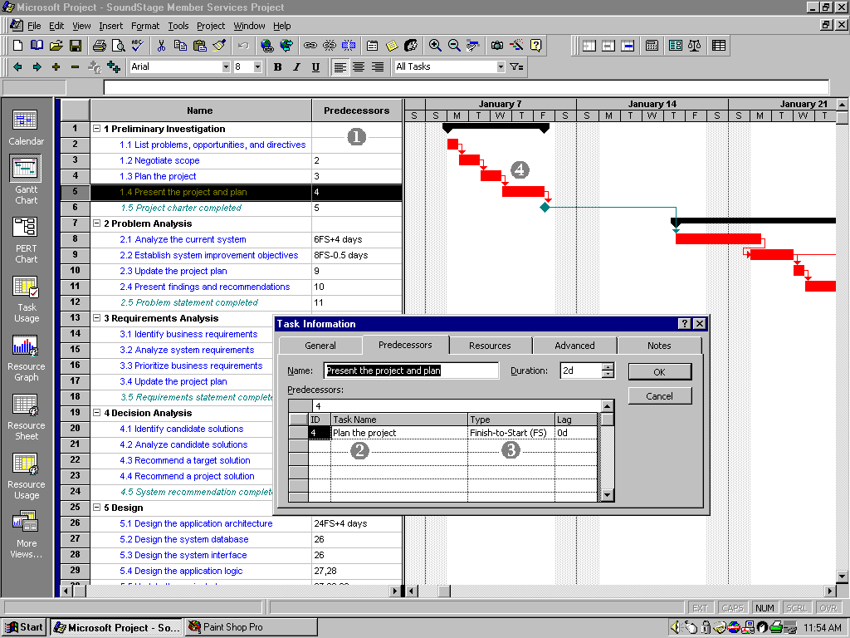
Memasukkan Ketergantungan Antar Tugas
Notes:
Chapter 2 Information System Building Blocks
Page 2-<number>
No additional notes

Slide 23
Strategi Penjadualan
Forward scheduling menentukan tanggal mulai proyek dan menjadwalkan ke depan dari tanggal tersebut. Berdasarkan durasi terencana tugas-tugas yang diperlukan,keantarketergantungan tugas-tugas dan alokasi sumber-sumber daya untuk menyelesaikan tugas-tugas tersebut, meng-proyeksi tanggal penyelesaian proyek dengan pengkalkulasian.
Reverse scheduling menentukan tenggat waktu proyek dan menjadwalkan mundur dari tanggal tenggat waktu tersebut. Tugas-tugas, durasinya, keantarketergantungan dan sumber-sumber daya harus dipertimbangkan untuk memastikan bahwa proyek tersebut dapat diselesaikan saat tenggat waktu.
Notes:
Chapter 2 Information System Building Blocks
Page 2-<number>
Teaching Notes
In the event that the project manager is given a deadline to meet, reverse scheduling strategy is ideal.

Slide 24
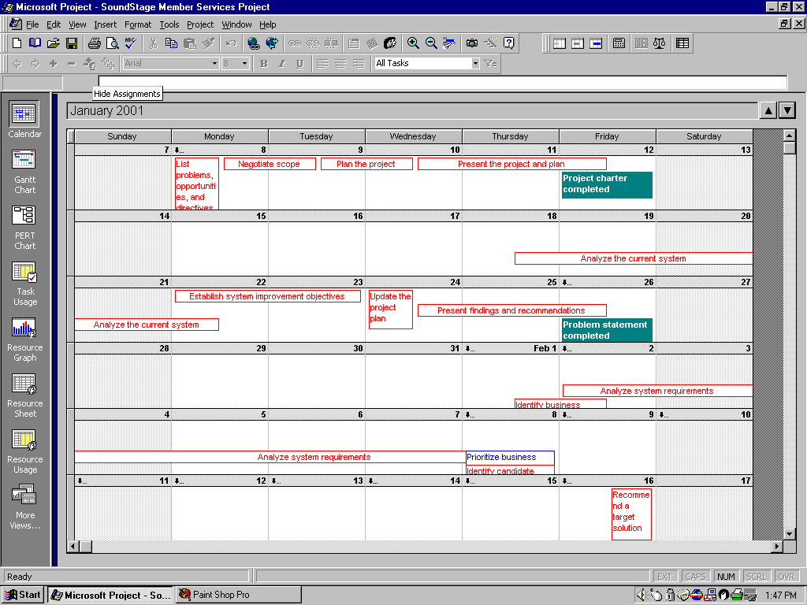
Jadwal Proyek dalam Tampilan Calender
Notes:
Chapter 2 Information System Building Blocks
Page 2-<number>
No additional notes

Slide 25
Aktifitas 5: Menugaskan Sumber-Sumber Daya
Orang—meliputi semua pemilik, pengguna, analis, desainer, developer, agen eksternal dan bantuan klerikal sistem yang akan dilibatkan dalam proyek.
Layanan—termasuk layanan-layanan seperti tinjauan kembali kualitas yang mungkin dibebankan pada basis tiap pemakaian.
Fasilitas-fasilitas dan perlengkapan—Meliputi semua ruangan dan teknologi yang akan diperlukan untuk menyelesaikan proyek.
Persediaan barang dan material—termasuk semua benda mulai dari pensil, kertas, buku catatan sampai cartridgetoner,dll.
Uang—termasuk penerjemahkan semua hal diatas ke dalam anggaran
Notes:
Chapter 2 Information System Building Blocks
Page 2-<number>
Teaching Notes
Before resources can be assigned to a project/task, the analyst must obtain the various stakeholders’ commitment of those resources.

Slide 26
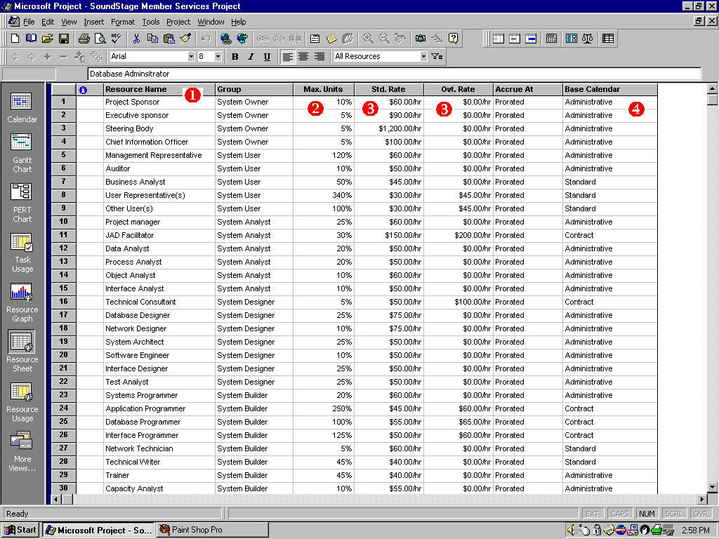
Mendefinisikan Sumber-sumber daya Proyek
Notes:
Chapter 2 Information System Building Blocks
Page 2-<number>
No additional notes

Slide 27
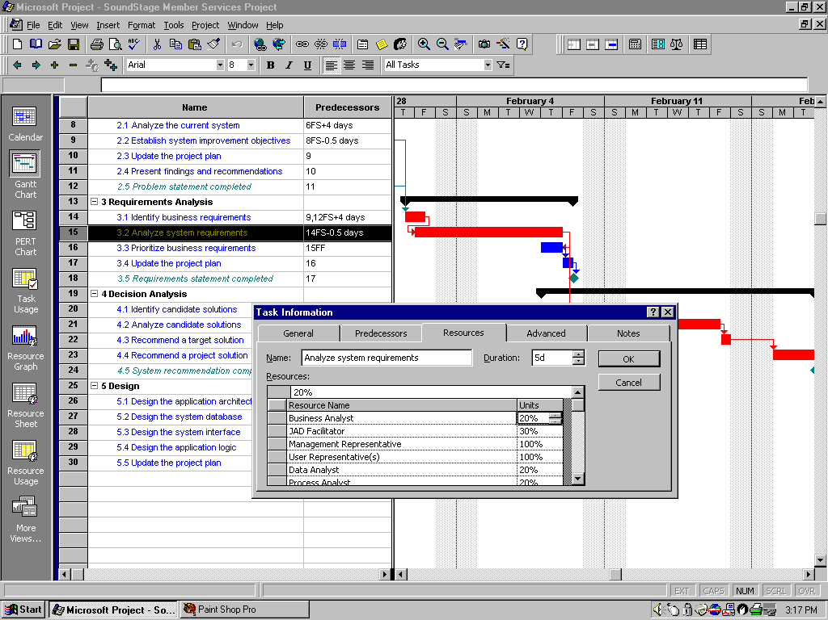
Menugaskan Sumber-sumber Daya Proyek
Notes:
Chapter 2 Information System Building Blocks
Page 2-<number>
No additional notes

Slide 28
Resource Leveling/Penyeimbangan Sumber Daya
Resource leveling adalah sebuah strategi yang digunakan untuk mengkoreksi sumber daya yang dialokasikan berlebihan dengan kombinasi penundaan atau pemecahan tugas-tugas.
Dua pendekatan dalam resource leveling:
task delaying/penundaan tugas-tugas
task splitting/pemecahan tugas-tugas
Notes:
Chapter 2 Information System Building Blocks
Page 2-<number>
Teaching Notes
It should be noted that resource leveling will be an ongoing activity since the schedule and resource assignments are likely to change over the course of a project.

Slide 29
Penundaan dan Pemecahan Tugas-tugas
Critical path sebuah proyek adalah urutan tugas-tugas tergantung yang memiliki jumlah terbesar dari most likely duration. Critical path menentukan tanggal penyelesaian paling awal proyek yang mungkin.
  Tugas-tugas pada critical path tidak dapat ditunda tanpa memasukkan jadual penundaan, karena akan menyebabkan penundaan penyelesaian keseluruhan proyek.
Slack time available for any noncritical task is the amount of delay that can be tolerated between the starting time and completion time of a task without causing a delay in the completion date of the entire project.
  Tasks that have slack time can be delayed to achieve resource leveling
Notes:
Chapter 2 Information System Building Blocks
Page 2-<number>
No additional notes

Slide 30
Activity 6: Direct the Team Effort
Supervision resources
  The DEADLINE – A Novel About Project Management
  The One Minute Manager
  The Care and Feeding of Monkeys
Stages of Team Maturity
(see figure to the right)
ORIENTATION STAGE
Ÿ
Establish structure and rules
FORMING
Ÿ
Clarify team member relationships
Ÿ
Identify responsibilities
Ÿ
Develop a plan to achieve goals
INTERNAL PROBLEM-SOLVING STAGE
Ÿ
Resolve interpersonal conflict
STORMING
Ÿ
Further clarify rules and goals
Ÿ
Develop a participative climate
GROWTH AND PRODUCTIVITY STAGE
Ÿ
Direct team activity toward goals
NORMING
Ÿ
Provide and get feedback
Ÿ
Share ideas–growing cohesion
Ÿ
Individuals feel good about each other
EVALUATION AND CONTROL STAGE
Ÿ
More feedback and evaluation
PERFORMING
Ÿ
Adherence to team norms
Ÿ
Roles of team strengthened
Ÿ
Strong team motivation to share goals
Notes:
Chapter 2 Information System Building Blocks
Page 2-<number>
No additional notes

Slide 31
Activity 7: Monitor and Control Progress
Progress reporting
Change management
Expectations management
Schedule adjustments—critical path analysis (CPA)
Notes:
Chapter 2 Information System Building Blocks
Page 2-<number>
No additional notes

Slide 32
Sample Outline for a Progress Report
I. Cover Page
A. Project name or identification
B. Project manager
C. Date or report
II. Summary of progress
A. Schedule analysis
B. Budget analysis
C. Scope analysis
(describe any changes that may have an impact on future progress)
D. Process analysis
(describe any problems encountered with strategy or methodology)
E. Gantt progress chart(s)
III. Activity analysis
A. Tasks completed since last report
B. Current tasks and deliverables
C. Short term future tasks and deliverables
IV. Previous problems and issues
A. Action item and status
B. New or revised action items
1. Recommendation
2. Assignment of responsibility
3. Deadline
(continued)
Notes:
Chapter 2 Information System Building Blocks
Page 2-<number>
Teaching Notes
Emphasize that this is merely a sample. Encourage students to consider that many organizations have their own reporting standards to report project progress. In addition, many methodologies provide templates for various reporting needs.

Slide 33
Sample Outline for a Progress Report (concluded)
V. New problems and issues
A. Problems
(actual or anticipated)
B. Issues
(actual or anticipated)
C. Possible solutions
1. Recommendation
2. Assignment of responsibility
3. Deadline
VI. Attachments
(include relevant printouts from project management software)
Notes:
Chapter 2 Information System Building Blocks
Page 2-<number>
Teaching Notes
Emphasize that this is merely a sample. Encourage students to consider that many organizations have their own reporting standards to report project progress. In addition, many methodologies provide templates for various reporting needs.

Slide 34
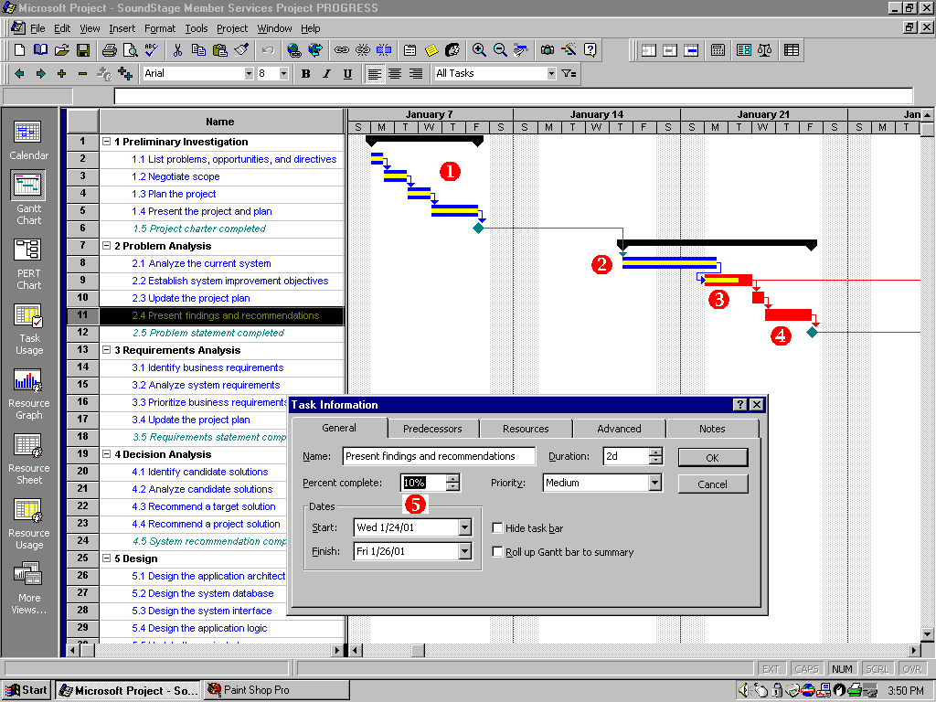
Progress on a Gantt Chart
Notes:
Chapter 2 Information System Building Blocks
Page 2-<number>
No additional notes

Slide 35
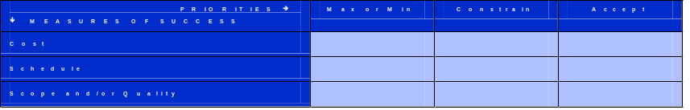
Expectations Management
An expectations management matrix is a rule-driven tool for helping management understand the dynamics and impact of changing project parameters such as cost, schedule, scope, and quality.
Notes:
Chapter 2 Information System Building Blocks
Page 2-<number>
No additional notes

Slide 36
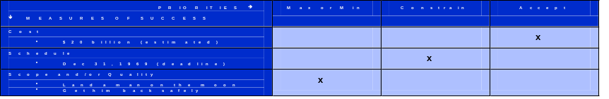
Lunar Project Expectations Management
Notes:
Chapter 2 Information System Building Blocks
Page 2-<number>
No additional notes

Slide 37

Typical, Initial Expectations for a Project
Notes:
Chapter 2 Information System Building Blocks
Page 2-<number>
No additional notes

Slide 38
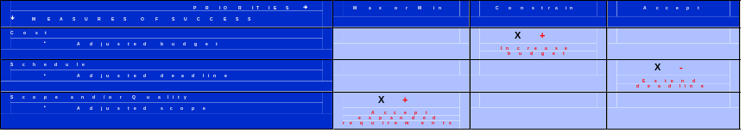
Adjusting Expectations
Notes:
Chapter 2 Information System Building Blocks
Page 2-<number>
No additional notes

Slide 39
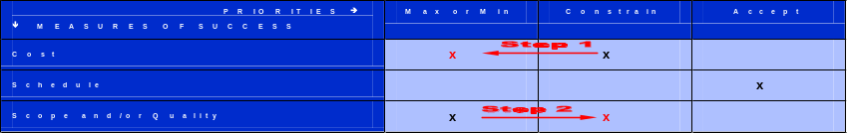
Changing Priorities
Notes:
Chapter 2 Information System Building Blocks
Page 2-<number>
No additional notes

Slide 40
Critical Path Analysis (and Slack Time)
Using intertask dependencies, determine every possible path through the project.
For each path, sum the durations of all tasks in the path.
The path with the longest total duration is the critical path.
  The critical path for a project is that sequence of dependent tasks that have the largest sum of most likely durations. The critical path determines the earliest completion date of the project.
  The slack time available for any noncritical task is the amount of delay that can be tolerated between the starting time and completion time of a task without causing a delay in the completion date of the entire project.
Notes:
Chapter 2 Information System Building Blocks
Page 2-<number>
Teaching Notes
The explanation of identifying the critical path is a simplified description. Identifying the critical path for large complex projects with many paths can be quite challenging. There are other approaches that can be used to identify the critical path (see Wysocki et al.).

Slide 41
Critical Path
TASK
D
Duration
Tue 2/20/01
7 days
Tue 2/20/01
0 days
TASK
A
TASK
B
TASK
C
TASK
E
TASK
I
Mon 2/5/01
3 days
Wed 2/7/01
2 days
Fri 2/9/01
2 days
Mon 2/19/01
6 days
Tue 2/27/01
5 days
Mon 2/5/01
0 days
Wed 2/7/01
0 days
Fri 2/9/01
0 days
Tue 2/20/01
1 day
Tue 2/27/01
0 days
TASK
F
TASK
G
The critical path is highlighted in red
Wed 2/14/01
3 days
Fri 2/16/01
2 days
Fri 2/16/01
2 days
Tue 2/20/01
2 days
Slack Time
TASK
H
Thu 2/15/01
1 day
Tue 2/20/01
3 days
Notes:
Chapter 2 Information System Building Blocks
Page 2-<number>
No additional notes

